Slide 1
Lake Park’s Interact Club

Slide 2
About Us
We bring together dedicated students who want to discover the power of service over self. Students are nominated by staff members who recognize their Lancer pride and ability to be a positive leader within the communities.

Slide 3
Mission Statement
Build community and connections across activities, athletics, and academics
Promote and model healthy decision making and lifestyles
Foster supportive, positive peer relationships

Slide 4
Mentorship
Leadership Training
Service
Interact Club
Lancer Nation
Decision Making
The Five Pillars

Slide 5
Lancer Nation
Determine/promote themes for athletic events
Strong social media presence
Lancer sign making for community
T-shirt sales

Slide 6
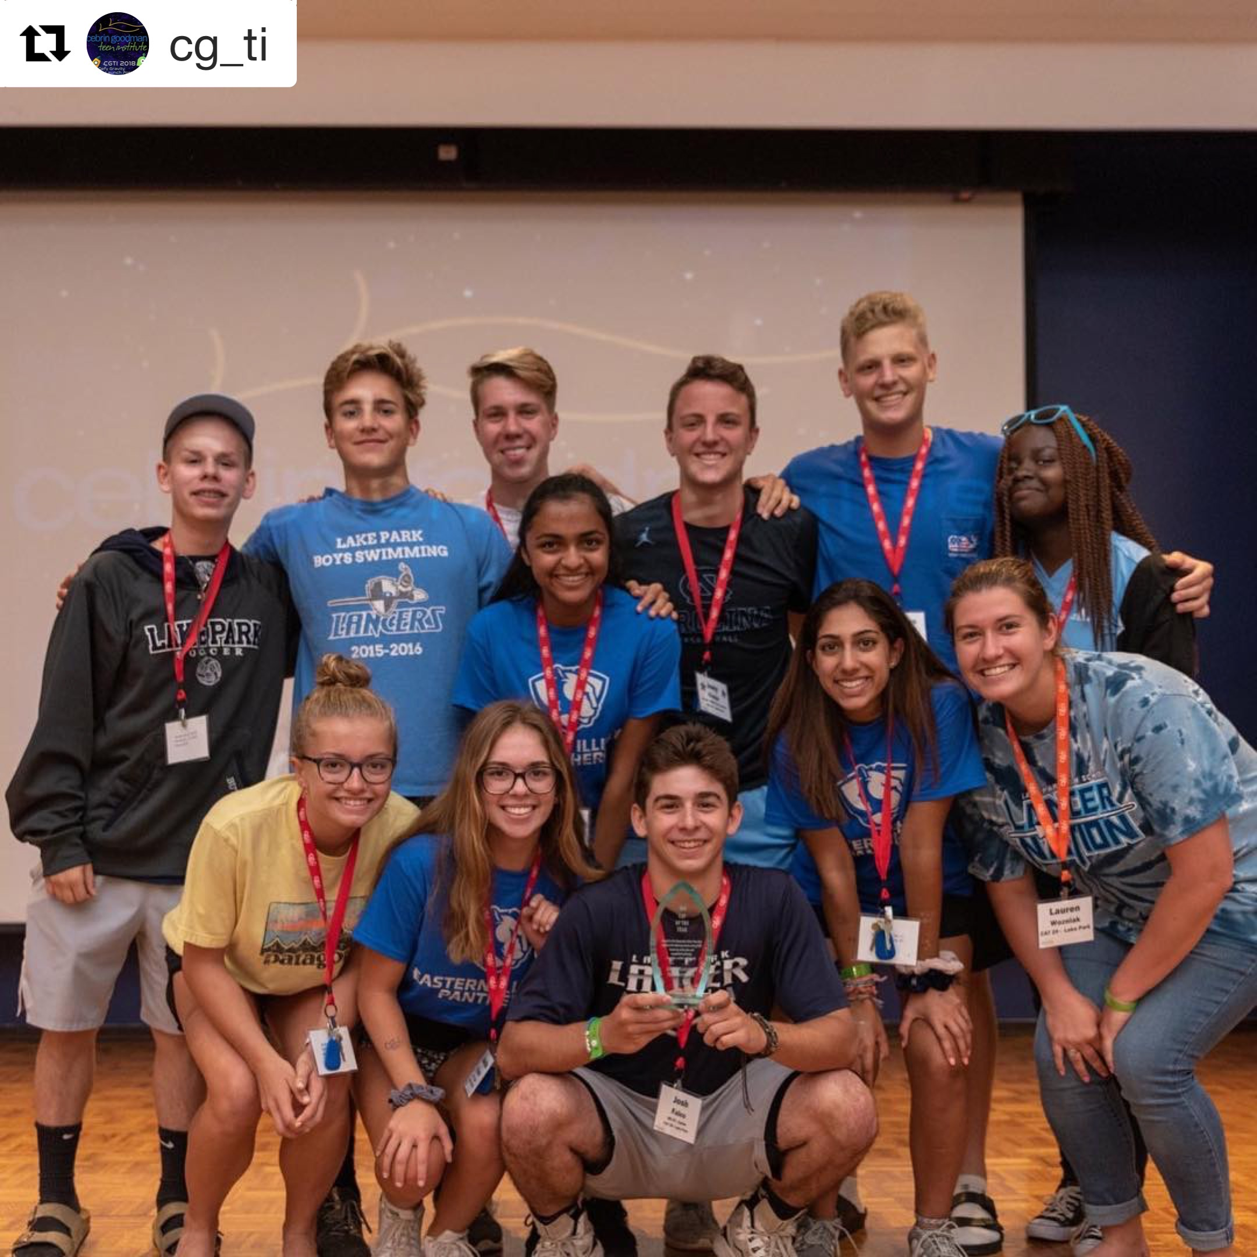
Leadership Training
Summer: CGTI Retreat (6 days)
Spring: RYLA Retreat (3 days)
Winter: CGTI Conference (2 days)
Various other opportunities throughout the school year
Attending
Training others

Slide 7
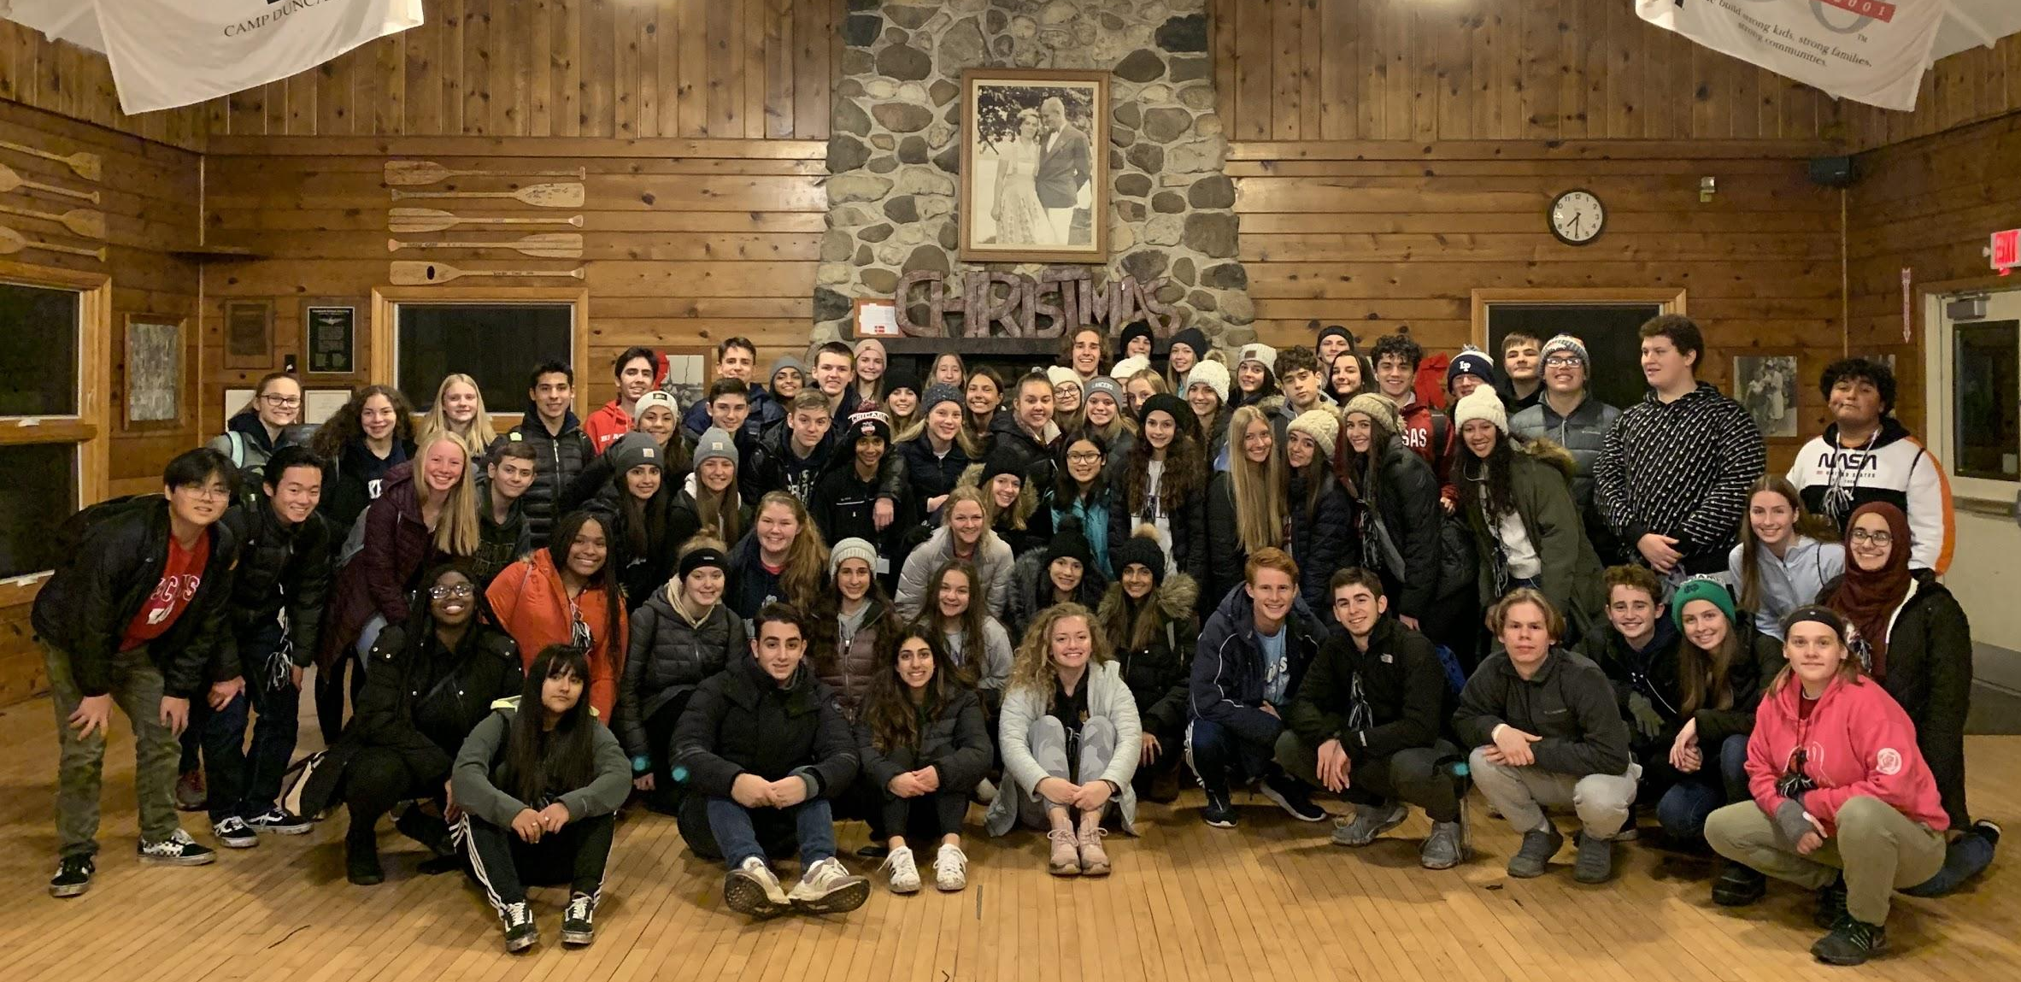
Mentorship
Link with middle schools
Junior Lancer conference
Middle school “tour”
Within school community
Advising
Academic edge

Slide 8
Service
Partnership with Key Club
Assist in making opportunities available for school community
Assist with in-school initiatives
Service & Action
Drives

Slide 9
Decision Making
Pre-prom/Prom activities
CGTI leaders (train others)
Opportunity to partner with District 211

Slide 10
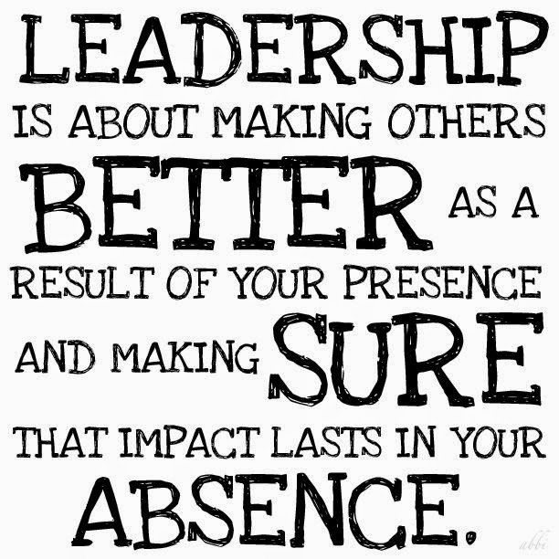
Questions?
Please contact sponsors:
Lauren Wozniak (EC) (lwozniak@lphs.org)
Mike Bundalo (WC) (mbundalo@lphs.org)
Jennifer Menold (WC)
(jmenold@lphs.org)

